Slide 1

A Big Data Spreadsheet
Mihai Budiu – VMware Research Group (VRG)
Google – October 10, 2018
Joint work with
Parikshit Gopalan, Lalith Suresh, Udi Wieder, Marcos Aguilera – VMware Research
Han Kruiger – ex-University of Groningen, intern at VRG

Slide 2


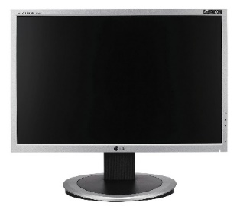
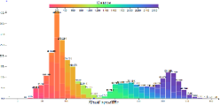
Browsing big data
Interactive visualization of billion row datasets
Slice and dice data with the click of a mouse
No coding required
http://github.com/vmware/hillview
Apache 2 license

Slide 3


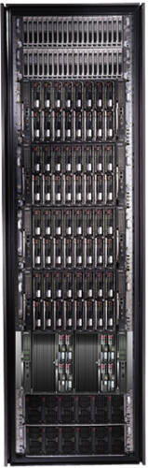
Bandwidth hierarchy
These channels are lossy!
Compute approximate data views with an error < channel error.

Slide 4
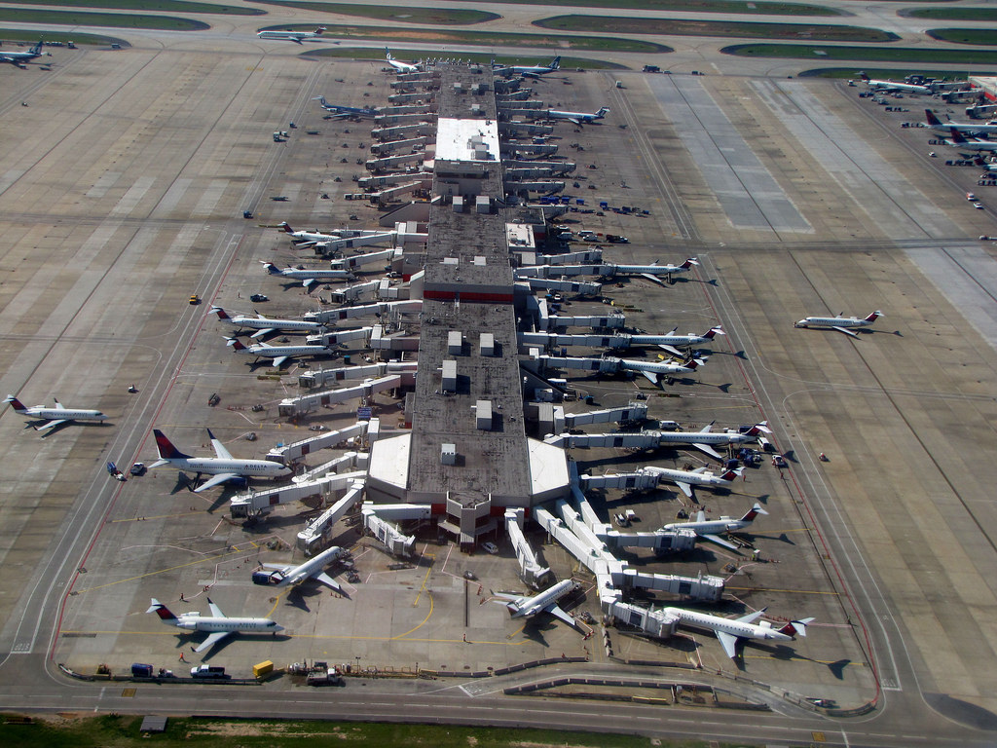
Demo
Real-time video
Browsing a 134 million
.5M flights/month
All US flights in last 21.5 years
Public data from FAA website
Running on 15 small VMs in Amazon’s cloud (8GB of RAM, 2 CPU cores each)
Video: https://1drv.ms/v/s!AlywK8G1COQ_jeRQatBqla3tvgk4FQ
Demo: http://ec2-18-217-136-170.us-east-2.compute.amazonaws.com:8080/

Slide 5

Outline
Motivation
Fundamental building blocks
System architecture
Visualization as sketches
Evaluation
Conclusion

Slide 6
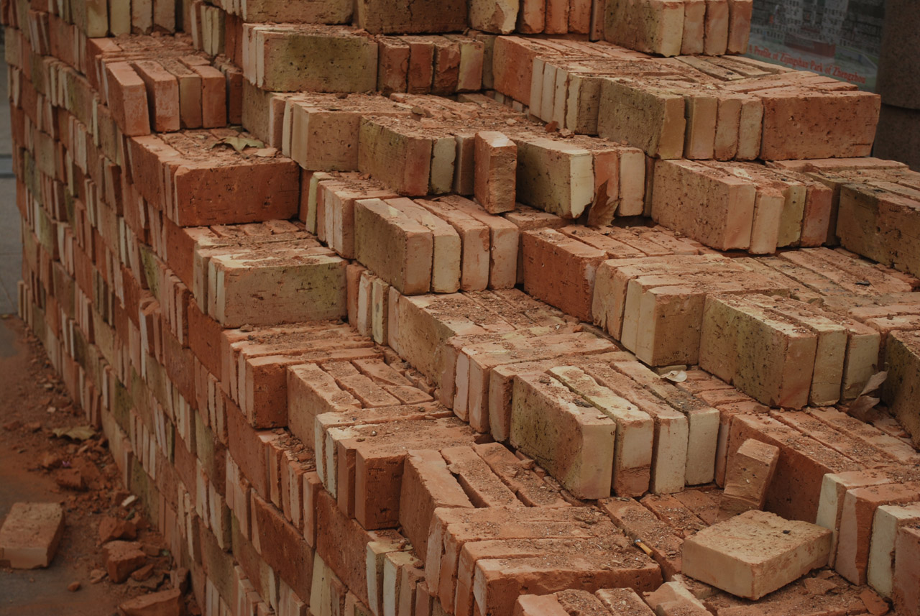
Hillview Building Blocks

Slide 7

Monoids
A set M with
An operation + : M x M -> M
Associative: (a + b) + c = a + (b + c)
A distinguished zero element: a + 0 = 0 + a = a
Commutative if a + b = b + a
interface IMonoid<R> { R zero(); R add(R left, R right);
}

Slide 8
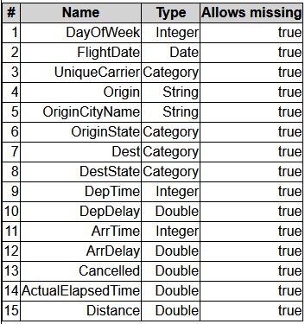
Abstract Computational Model
Output O
Post
processing
“sketch”
R must be “small”
(independent on N,
dependent on screen size)
R
add
R
R
add
add
R
R
R
R
Streaming/ sampling algorithm
sketch
sketch
sketch
sketch
Input data, sharded
Multi-set of N tuples

Slide 9
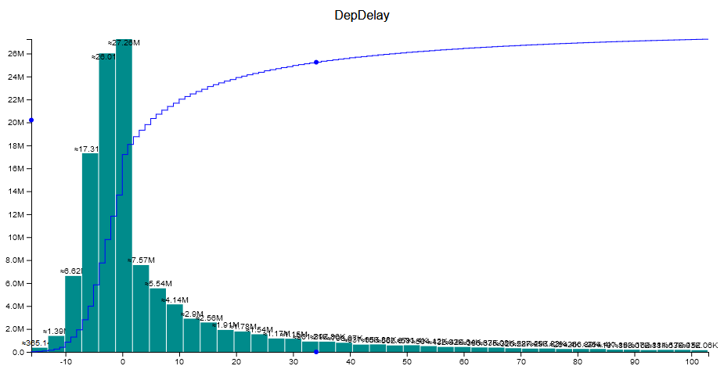
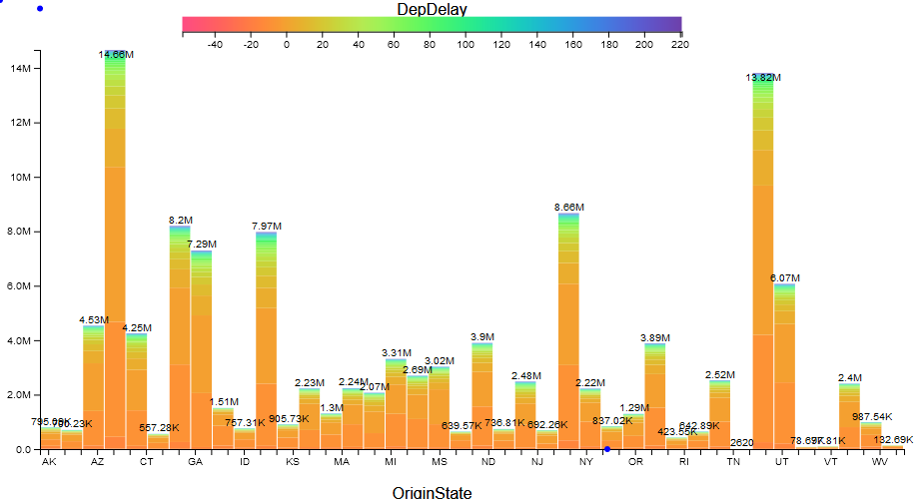
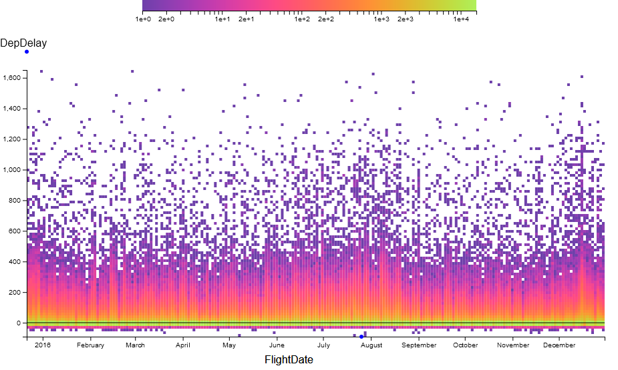
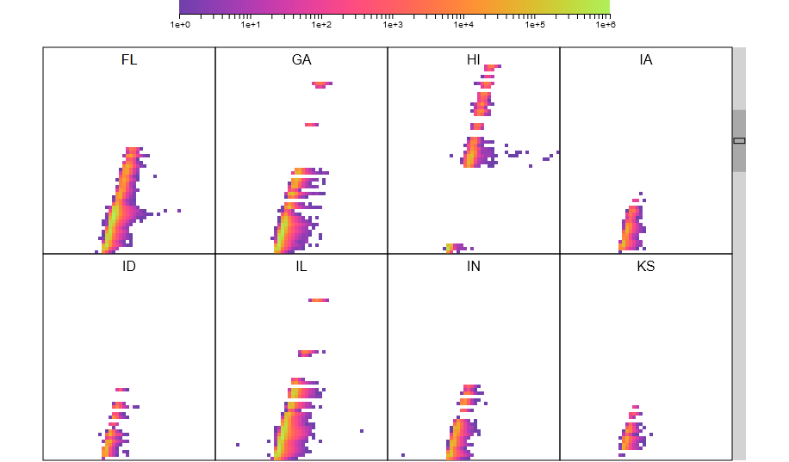
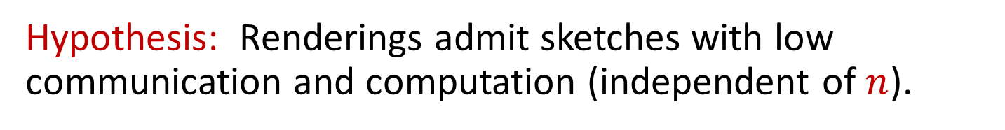
All Renderings in Hillview are sketches!
Hypothesis: Renderings admit sketches with low communication and computation (independent of $n$).

Slide 10
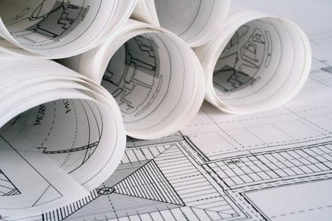
System architecture

Slide 11
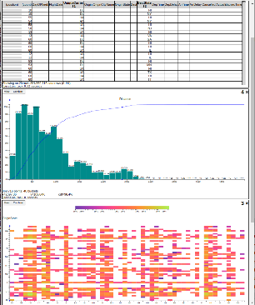


Hillview System architecture
workers
Leaf
node
In-memory
table
parallel
read
Aggregation
node
Leaf
node
In-memory
table
Web front-end
Root
node
In-memory
table
Storage
Leaf
node
In-memory
table
request
In-memory
table
Storage
Remote tables refs.
Aggregation
node
Leaf
node
In-memory
table
streaming
response
In-memory
table
Storage
Redo log
In-memory
table
Client
web browser
Storage
Aggregation network
Hillview cloud service

Slide 12
Immutable Partitioned Objects
browser
handle
root node
Address spaces
Network
IDataSet<T>
T
T
T
T
T
T
T
T
T
T
T
Workers

Slide 13

DataSet Core API
interface ISketch<T,R> extends IMonoid<R> { R sketch(T data); }
interface PR<T> { // Partial result T data; double done; }
interface IDataSet<T> { Observable<PR<R>> sketch(ISketch<T,R> sk); … map(…); … zip(…); }

Slide 14
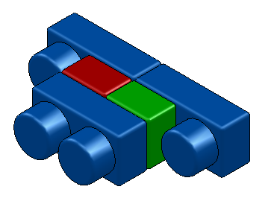
Dataset objects
Implement IDataSet<T>
Identical interfaces on top and bottom
Can be stacked arbitrarily
Modular construction of distributed systems
IDataSet
interface

Slide 15
LocalDataset<T>
Contains a reference to an object of type T in the same address space
Directly executes operations (map, sketch, zip) on object
Local
T

Slide 16
ParallelDataset<T>
Has a number of children of type IDataSet<T>
Dispatches operations to all children
sketch adds the results of children
Parallel

Slide 17
RemoteDataset<T>
Has a reference to an IDataSet<T> in another address space
The only component that deals with the network
Built on top of GRPC
Client
Remote
ref
GRPC
Server

Slide 18
A distributed dataset
Root node
Parallel
Remote
Remote
Network
worker 0
ref
worker 1
ref
ref
worker n
Parallel
Parallel
Remote
Parallel
Parallel
Local
Local
Local
Local
Local
Local
T
T
Rack 0
T
T
T
Rack r
T

Slide 19
sketch(s)
interface ISketch<T,R> extends IMonoid<R> { R sketch(T data); }
R
Remote
s.add
R
Parallel
R
R
Local
Local
s.sketch
T
T

Slide 20
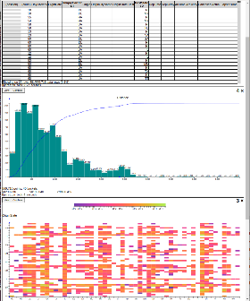
Memory management
Web front-end
Root
node
Leaf
node
In-memory
table
Memoization
cache
Remote tables refs.
In-memory
table
Storage
Redo log
Soft state (cache)
Log = lineage of all datasets
Log = JSON messages received from client
Replaying the log reconstructs all soft-state
Log can be replayed as needed

Slide 21

Visualization as sketches

Slide 22
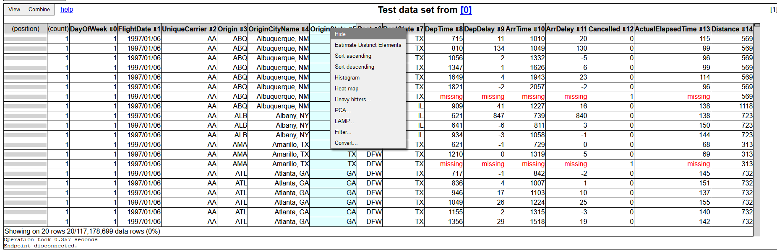
Table views
Always sorted
NextK(startTuple, sortOrder, K)
Monoid operation is “merge sort”

Slide 23
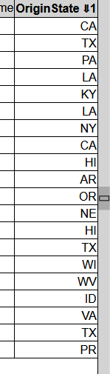
Scrolling
Compute startTuple based on scroll-bar position
Approximate quantile
Samples O(H²) rows; H = screen height in pixels

Slide 24
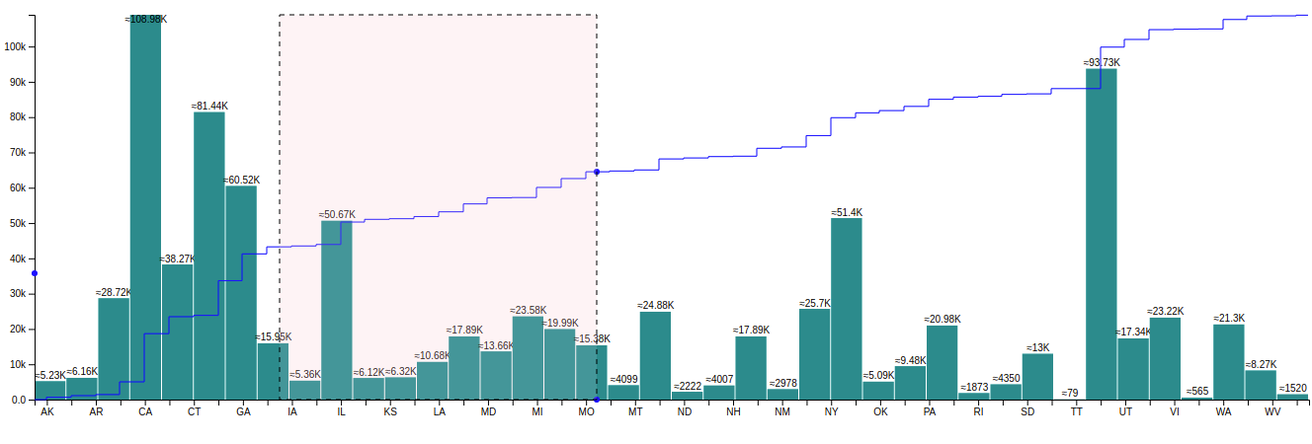
1D Histograms
CDF
Histograms are monoids (vector addition)
CDFs are histograms (at the pixel level)

Slide 25
Histograms based on sampling
Exact histogram
Approximate histogram
μ < 1/2
Actual
Legal rendering
Actual
Legal rendering
Legal rendering
pixel row
Theorem: O((HB / μ)² log(1/δ)) samples are needed to compute an approximate histogram with probability 1 – δ.
H = screen size in pixels
B = number of buckets (< screen width in pixels)
No N in this formula!

Slide 26
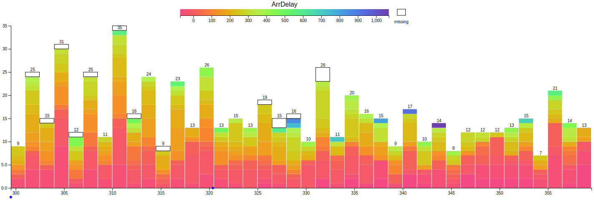
2D Histograms

Slide 27
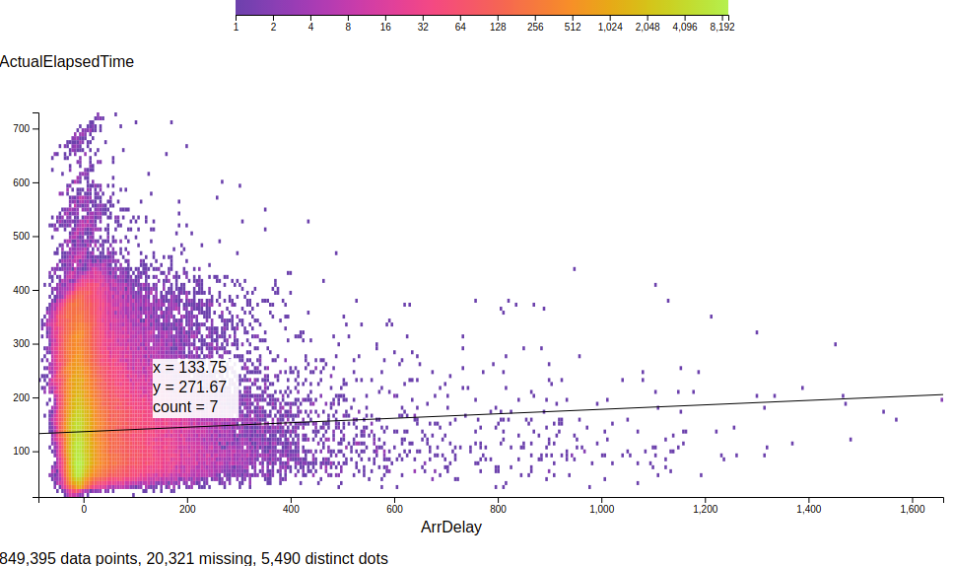
Heatmaps
Linear regression

Slide 28
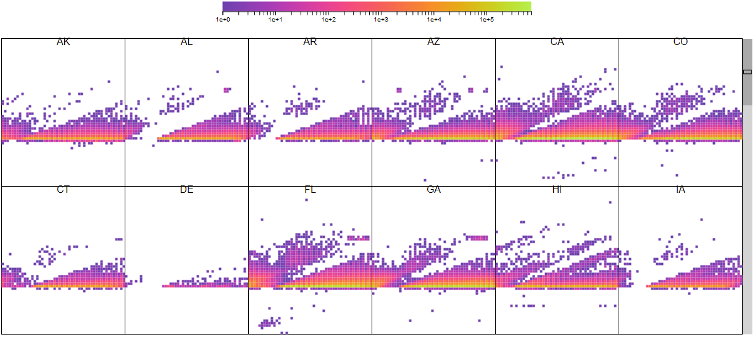
Trellis plots

Slide 29

Evaluation

Slide 30
Evaluation system
TOR switch
LAN
Web front-end
Root aggregator
Worker
8 servers
Intel Xeon Gold 5120 2.2GHz (2 sockets x 14 cores x 2 hyperthreads)
128GB RAM/machine
Ubuntu Server
10Gbps Ethernet in rack
2 SSDs/machine
client
…
Worker
Worker
rack

Slide 31
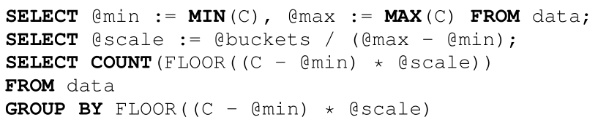
Comparison against database
Commercial database [can’t tell which one]
In-memory table
100M rows
DB takes 5,830ms (Hillview is 527ms)

Slide 32
Cluster-level weak scaling
Histogram, 100M elements/shard, 64 shards/machine
Computation gets faster as dataset size grows!

Slide 33
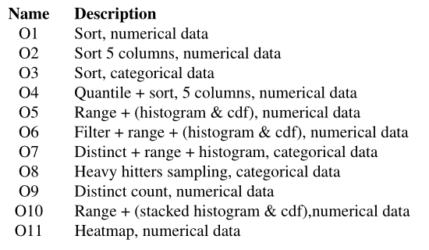
Comparison against Spark
5x the flights dataset (71B cells)
Spark times do not include UI rendering

Slide 34
Scaling data
5x | 71B cells
10x | 143B cells
100x | 1.43T cells
ORC data files, includes I/O and rendering

Slide 35
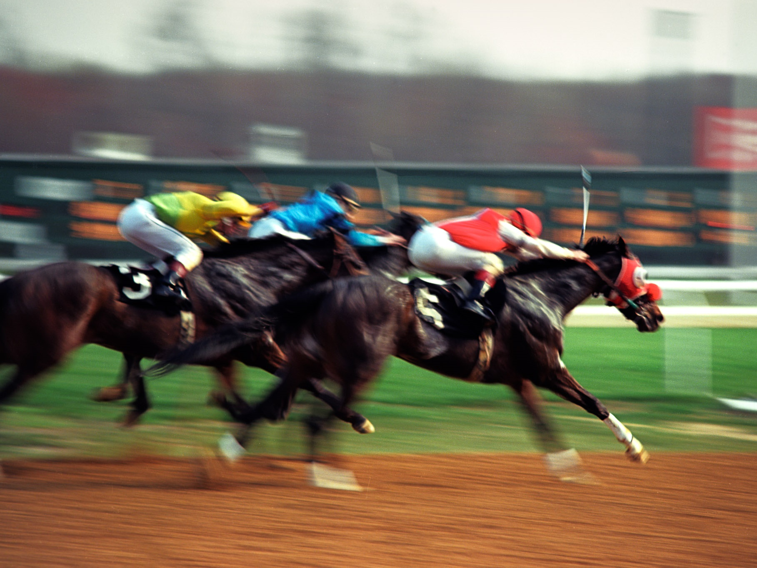
Conclusion

Slide 36

Lessons learned
Always think asymptotics (data size/screen size)
Define “correct approximation” precisely
Small renderings make browser fast
Two kinds of visualizations: trends and outliers
Don’t forget about missing data!
Sampling is not free; full scans may be cheaper
Redo log => simple memory management

Slide 37
Related work [a small sample]
Big data visualization
Databases, commercial products Polaris/Tableau, IBM BigSheets, inMens, Nanocubes, Hashedcubes, DICE, Erma, Pangloss, Profiler, Foresight, iSAX, M4, Vizdom, PowerBI
Big data analytics for visualization
MPI Reduce, Neptune, Splunk, MapReduce, Dremel/BigQuery, FB Scuba, Drill, Spark, Druid, Naiad, Algebird, Scope, ScalarR
Sampling-based analytics
BlinkDB, VisReduce, Sample+Seek, G-OLA
Incremental visualization
Online aggregation, progressive analytics, ProgressiVis, Tempe, Stat, SwiftTuna, MapReduce online, EARL, Now!, PIVE, DimXplorer

Slide 38
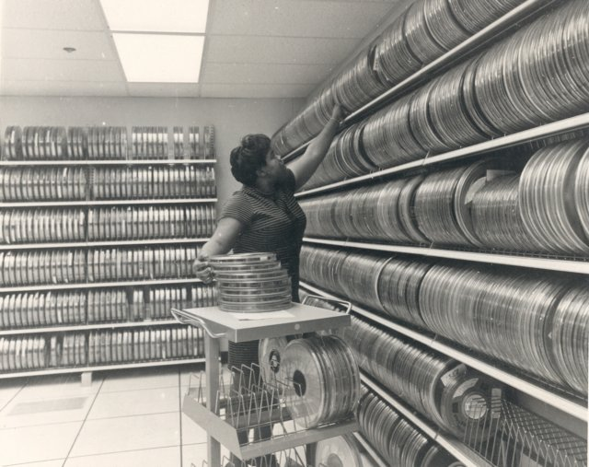
Backup slides

Slide 39




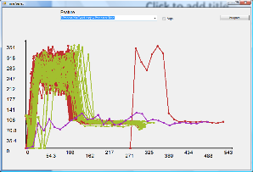
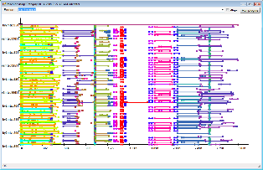
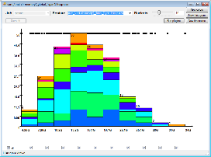
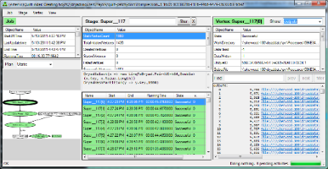
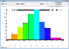
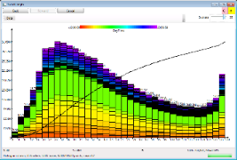
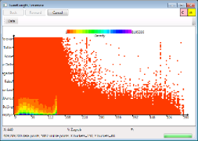
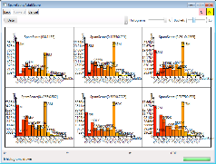
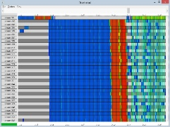
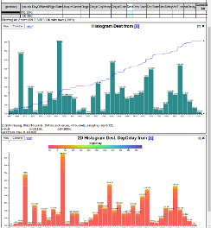
History
2006 | Dryad (Eurosys 2007) deployed by Microsoft Live Search
2008 | DryadLINQ (OSDI 2008); Artemis DryadLINQ job profiler (WASL 2008)
2011 | Daphne DryadLINQ job debugger (HIPS 2011); Fay distributed safe tracing (SOSP 2011)
2014 | Sketch spreadsheet (EGPGV 16) [MSR SVC closed]
2016

Slide 40

Linear transformations (homomorphisms)
Linear functions between monoids: f: M → N, f(a + b) = f(a) + f(b)
“Map” and “reduce” are linear functions
Linear transformations are the essence of data parallelism
Many streaming algorithms are linear transformations

Slide 41
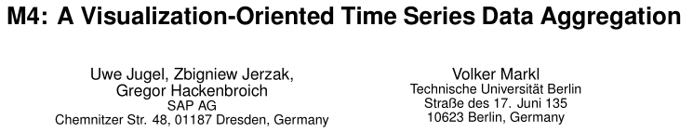
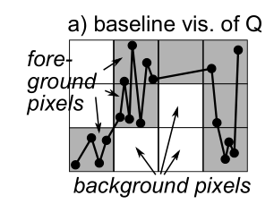
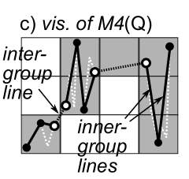
Pixel-level quantization

Slide 42

Reactive streams (RxJava)
interface Observable<T> { Subscription subscribe(Observer<T> observer); } interface Observer<T> { void onNext(T value); void onError(Throwable error); void onCompleted(); }
March 2012

Slide 43
Histogram execution timeline
Progress report
Render
User click
Data range
Initiate
histogram
Completed
Client
Web server
Data range
Histogram
+ CDF
Worker 1
Time
Compute
Worker n
Full scan
Sampled scan

Slide 44

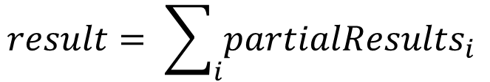
Observable roles (1)
Streaming data
Observable<R> partialResults;
$$result= \sum_{i}{{partialResults}_{i}}$$

Slide 45
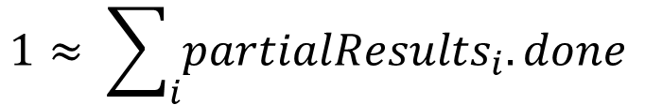
Observable roles (2)
Distributed progress reporting
class PR<T> { // A partial result double done; T data; }
Observable<PR<R>> partialResults;
$$1≈ \sum_{i}{{partialResults}_{i}.done}$$

Slide 46

Observable roles (3)
Distributed cancellation
Sketch API (C#)
async R map(Func<T, R> map, CancellationToken t, Progress<double> rep)
CancellationToken ct = cancellationTokenSource.token; Progress<double> reporter;
R result = data.map(f, ct, reporter); …
cancellationTokenSource.cancel();
Hillview API
Observable<PR<R>> map(Function<T, R> map);
Observable<PR<R>> o = data.map(f);
Subscription s = o.subscribe(observer);
…
s.unsubscribe();

Slide 47

Observable roles (4)
Concurrency management
Observable<T> data;
Observable<T> output = data.subscribeOn(scheduler);

Slide 48
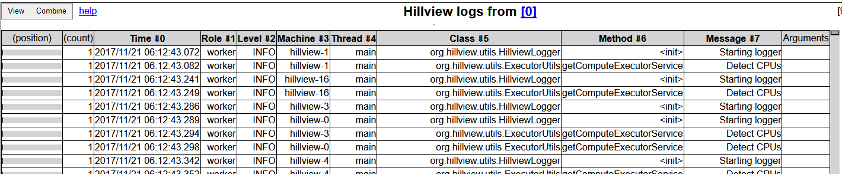
A log browser in Hillview
Spreadsheet
DataSet<Table>
Log parser
Distributed logs

Slide 49
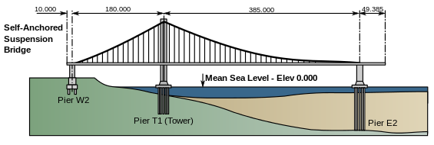
Hillview Design principles
Take display and perception limits into account
Wherever possible compute on sampled data
Compute views lazily (when users need them)
Shard data to exploit parallelism and increase responsiveness
Push computation to data
Only use sketching algorithms
Avoid hard state
Functional programming; immutable objects
Incremental view updates

Slide 50
map(f)
Remote
Remote
Parallel
Parallel
Local
Local
Local
Local
T
T
S
S
f
f

Slide 51
zip
Remote
Remote
Remote
Parallel
Parallel
Parallel
Local
Local
Local
Local
Local
Local
T
T
S
S
T,S
T,S

Slide 52
Spreadsheet architecture
UI
Front-end
DataSet<Table>
Distributed objects
Table operations
Spreadsheet logic
SQL DB
CSV Files
Column store
…
Storage layer

Slide 53
Table data storage
Table₁
Table₂
Schema₁
Columns
Columns
Schema₂
Membership
set
Membership
set
Column
data

Slide 54

MembershipSet operations
Iterate
Sample
GetIteratorOverSample
Ideally cost should be O(|output|)
Union/intersection/etc.
Multiple implementations, depending on sparsity

Slide 55

Scripting
We expose JavaScript to users
Create new columns
Write data filters
Oracle Java Nashorn JS engine

Slide 56
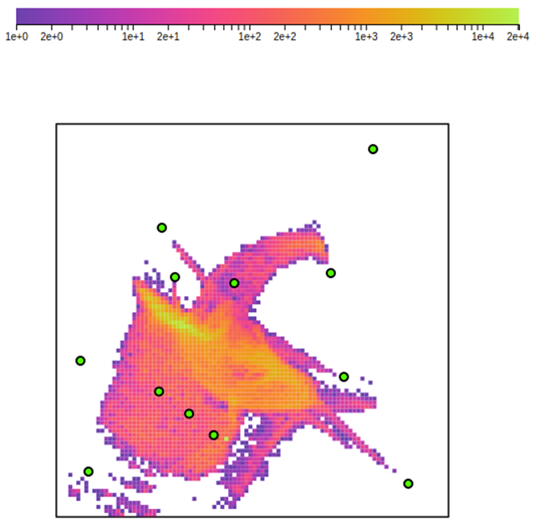
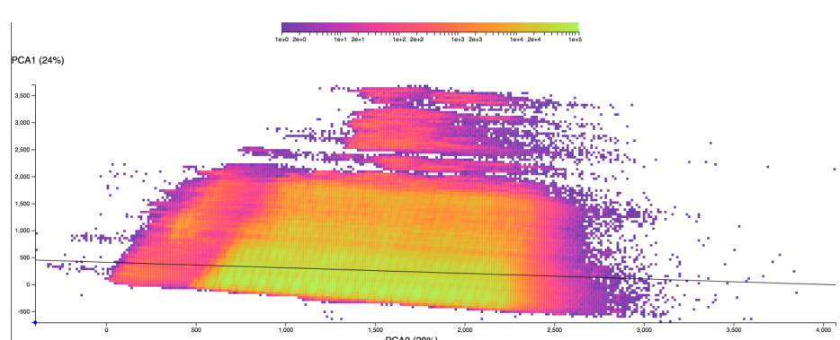
Dimensionality reduction
PCA
Covariance matrix computation is a sketch
Local Affine Multidimensional Scaling

Slide 57
Weak scaling - throughput

Slide 58
Service capacity

Slide 59
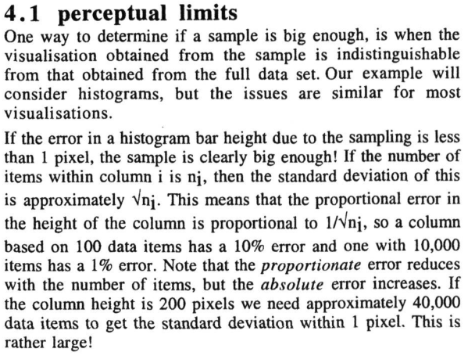

Approximate renderings

Slide 60
Sampling/Streaming for Databases/Visualization
Sampling to estimate the size of database queries. [Lipton-Naughton’89]
Streaming for estimating skew in databases [Alon-Matais-Szegedy’96]
Approximate renderings via sampling [Dix-Ellis’02]
Sampling to estimate relative orderings in renderings. [Kim-Blais-Parameswaran-Indyk-Madden-Runbinfeld’14]
Sampling to compute incremental renderings. [Rahman-Aliakbarpour-Kong-Blais-Karahalios-Parameswaran-Rubinfield’17]

Slide 61
Scrolling
aardvark
$h$ vertical pixels.
Each pixel represents a quantile.
Scrolling displays a screenful of consecutive records from this quantile.
earwig
….
ermine
zyzzyva

Slide 62
Scrolling
aardvark
$h$ vertical pixels.
Each pixel represents a quantile.
Step 1: Approximate quantile query: sampling ${O(h}^{2})$ elements suffices.
echidna
zyzzyva

Slide 63
Scrolling
aardvark
$h$ vertical pixels.
Each pixel represents a quantile.
Step 1: Approximate quantile query: sampling ${O(h}^{2})$ elements suffices.
Step 2: Given the top row, find the Next K in sorted order.
Sketch: single pass
Merge: mergeSort
echidna
echinoderm
ermine
zyzzyva

